Slide 1

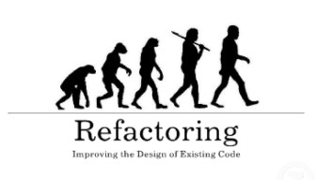
Refactoring: Improving the Quality of Existing Code
When and How to Refactor? Refactoring Patterns
High-Quality Code
Telerik Software Academy
http://academy.telerik.com

Slide 2

Table of Contents
What is Refactoring?
Refactoring principles
Refactoring process and tips
Code smells
Refactorings
Data level, statement level, method level, class level, system level refactorings, etc.
Refactoring patterns

Slide 3

What is Refactoring?
Refactoring means "to improve the design and quality of existing source code without changing its external behavior".
Martin Fowler
It is a step by step process that turns the bad code into good code
Based on "refactoring patterns" → well-known recipes for improving the code

Slide 4
Code Refactoring
What is refactoring of the source code?
Improving the design and quality of existing source code without changing its behavior
Step by step process that turns the bad code into good code (if possible)
Why we need refactoring?
Code constantly changes and its quality constantly degrades (unless refactored)
Requirements often change and code needs to be changed to follow them

Slide 5

When to Refactor?
Bad smells in the code indicate need of refactoring
Refactor:
To make adding a new function easier
As part of the process of fixing bugs
When reviewing someone else’s code
Have technical debt (or any problematic code)
When doing test-driven development
Unit tests guarantee that refactoring does not change the behavior
If there are no unit tests, write them

Slide 6
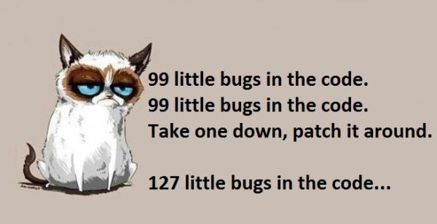
Good Code Main Principles
Avoid duplication (DRY)
Simplicity – Keep it simple stupid (KISS)
Make it expressive (self-documenting, comments)
Reduce overall code (YAGNI)
More code = more bugs
Avoid premature optimization
Appropriate level of abstraction
Hide implementation details
Boy scout rule
Leave your code better than you found it

Slide 7
Good Code Main Principles (2)
Don’t make me think
Code should surprise the reader as little as possible (principle of least astonishment)
Consistency!
Write code for the maintainer
Unit test
SOLID
Single responsibility principle
Open/closed principle
Liskov substitution principle
Interface segregation principle
Dependency inversion principle

Slide 8
Refactoring Process
Save the code you start with
Check-in or backup the current code
Make sure you have tests to assure the behavior after the code is refactored
Unit tests / characterization tests
Do refactorings one at a time
Keep refactorings small
Don’t underestimate small changes
Run the tests and they should pass / else revert
Check-in

Slide 9
Refactoring Tips
Keep refactorings small
One at a time
Make a checklist
Make a "later"/TODO list
Check-in/commit frequently
Add tests cases
Review the results
Pair programming
Use tools (Visual Studio + Add-ins)

Slide 10
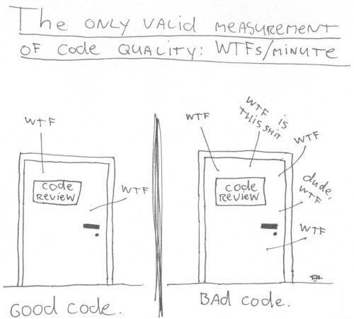
Code Smells

Slide 11
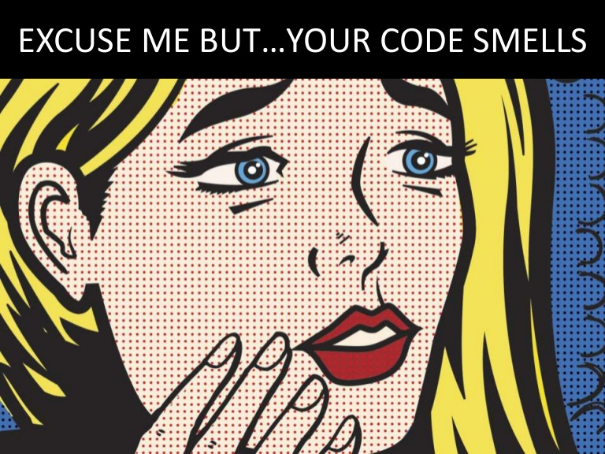
Code Smells
Certain structures in the code that suggest the possibility of refactoring
Types of code smells
The bloaters
The obfuscators
Object-oriented abusers
Change preventers
Dispensables
The couplers

Slide 12

Code Smells: The Bloaters
Long method
Small methods are always better (easy naming, testing, understanding, less duplicate code)
Large class
Too many instance variables or methods
Violating Single Responsibility principle
Primitive obsession (overused primitives)
Over-use of primitives, instead of better abstraction
Part of them can be extracted in separate class and encapsulate their validation there

Slide 13

Code Smells: The Bloaters (2)
Long parameter list (in/out/ref parameters)
May indicate procedural rather than OO style
May be the method is doing too much things
Data clumps
A set of data items that are always used together, but are not organized together
E.g. credit card fields in order class
Combinatorial explosion
Ex. ListCars, ListByRegion, ListByManufacturer, ListByManufacturerAndRegion, etc.
Solution may be Interpreter (LINQ)

Slide 14

Code Smells: The Bloaters (3)
Oddball solution
A different way of solving a common problem
Not using consistency
Solution: Substitute algorithm or use adapter
Class doesn't do much
Solution: Merge with another class or remove
Required setup/teardown code
Requires several lines of code before its use
Solution: Use parameter object, factory method, IDisposable

Slide 15
Code Smells: The Obfuscators
Regions
The intend of the code is unclear and needs commenting (smell)
The code is too long to understand (smell)
Solution: organize code, introduce a new class
Comments
Should be used to tell WHY, not WHAT or HOW
Good comments: provide additional information, link to issues, explain reasons, give context
Link: Funny comments

Slide 16
Code Smells: The Obfuscators (2)
Poor/improper names
Should be proper, descriptive and consistent
Vertical separation
You should define variables just before first use
Avoid scrolling
Inconsistency
Follow the POLA
Inconsistency is confusing and distracting
Obscured intent
Code should be as expressive as possible

Slide 17
Code Smells: OO Abusers
Switch statement
Can be replaced with polymorphism
Temporary field
When passing data between methods
Class depends on subclass
The classes cannot be separated (circular dependency)
May broke Liskov substitution principle
Inappropriate static
Strong coupling between static and callers
Static things cannot be replaced or reused

Slide 18
Code Smells: Change Preventers
Divergent change
A class is commonly changed in different ways for different reasons
Violates SRP (single responsibility principle)
Solution: extract class
Shotgun surgery
One change requires changes in many classes
Hard to find them, easy to miss some
Solution: move method, move fields
Ideally there should be one-to-one relationship between common changes and classes

Slide 19
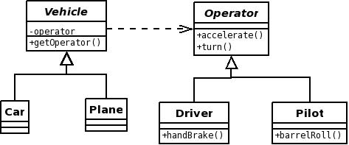
Code Smells: Change Preventers
Parallel inheritance hierarchies
New vehicle = new operator
Frequently share same prefix
Hard to be completely avoided. We can merge the classes or use the Intelligent children pattern
Inconsistent abstraction level
E.g. code in a method should be one level of abstraction below the method's name

Slide 20
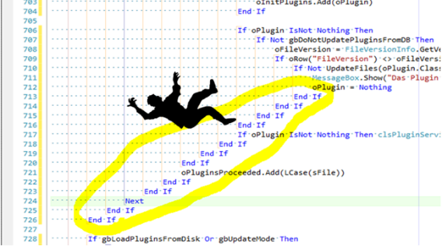
Code Smells: Change Preventers
Conditional complexity
Cyclomatic complexity
number of unique paths that the code can be evaluated
Symptoms: deep nesting (arrow code) & bug ifs
Solutions: extract method, strategy pattern, state pattern, decorator
Poorly written tests
Badly written tests can prevent change
Tight coupling

Slide 21
Code Smells: Dispensables
Lazy class
Classes that don't do enough to justify their existence should be removed
Every class costs something to be understand and maintained
Data class
Some classes with only fields and properties
Missing validation? Class logic split into other classes?
Solution: move related logic into the class

Slide 22
Code Smells: Dispensables (2)
Duplicated code
Violates the DRY principle
Result of copy-pasted code
Solutions: extract method, extract class, pull-up method, template method pattern
Dead code (code that is never used)
Usually detected by static analysis tools
Speculative generality
"Some day we might need…"
YAGNI principle

Slide 23
Code Smells: The Couplers
Feature envy
Method that seems more interested in a class other than the one it actually is in
Keep together things that change together
Inappropriate intimacy
Classes that know too much about one another
Smells: inheritance, bidirectional relationships
Solutions: move method/field, extract class, change bidirectional to unidirectional association, replace inheritance with delegation

Slide 24
Code Smells: The Couplers (2)
The Law of Demeter (LoD)
Principle of least knowledge
A given object should assume as little as possible about the structure or properties of anything else
Bad e.g.: customer.Wallet.RemoveMoney()
Indecent exposure
Some classes or members are public but shouldn't be
Violates encapsulation
Can lead to inappropriate intimacy

Slide 25
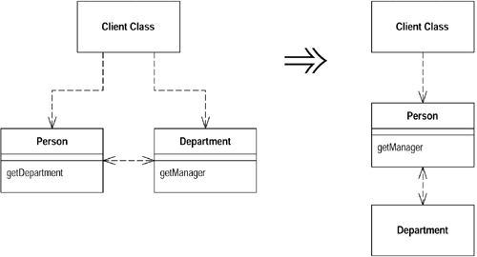
Code Smells: The Couplers (3)
Message chains
Somemthing.another.someother.other.another
Tight coupling between client and the structure of the navigation
Middle man
Sometimes delegation goes too far
Sometimes we can remove it or inline it
Tramp data
Pass data only because something else need it
Solutions: Remove middle man, extract class

Slide 26
Code Smells: The Couplers (4)
Hidden temporal coupling
Occurs when members of a class requires clients to invoke one member before the other
Operations consecutively should not be guessed
E.g. The use of Pizza class should not know the steps of making pizza
Builder or Template Method pattern
Hidden dependencies
Classes should declare their dependencies in their constructor
"new" is glue / Dependency Inversion principle

Slide 27
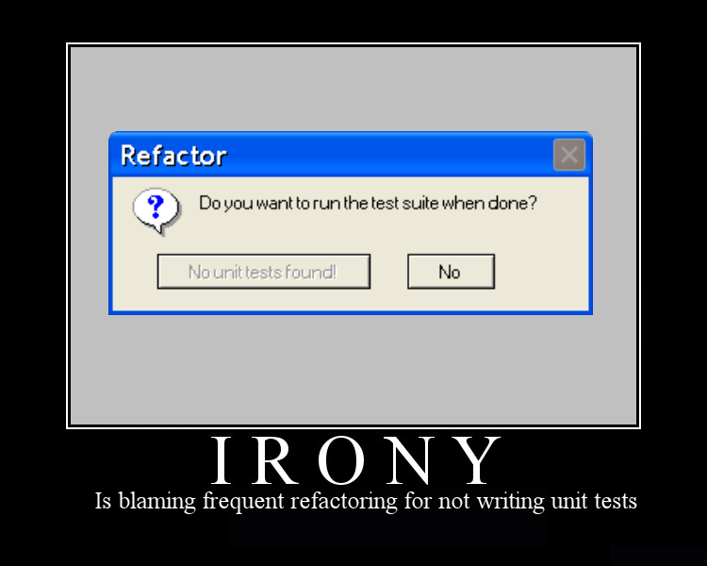
Refactorings

Slide 28

Data Level Refactorings
Replace a magic number with a named constant
Rename a variable with more informative name
Replace an expression with a method
To simplify it or avoid code duplication
Move an expression inline
Introduce an intermediate variable
Introduce explanatory variable
Convert a multi-use variable to a multiple single-use variables
Create separate variable for each usage

Slide 29
Data Level Refactorings (2)
Create a local variable for local purposes rather than a parameter
Convert a data primitive to a class
Additional behavior / validation logic (money)
Convert a set of type codes (constants) to enum
Convert a set of type codes to a class with subclasses with different behavior
Change an array to an object
When you use an array with different types in it
Encapsulate a collection (list of cards => deck)

Slide 30

Statement Level Refactorings
Decompose a boolean expression
Move a complex boolean expression into a well-named boolean function
Consolidate duplicated code in conditionals
Return as soon as you know the answer instead of assigning a return value
Use break or return instead of a loop control variable
Replace conditionals with polymorphism
Use null objects instead of testing for nulls

Slide 31

Method Level Refactorings
Extract method / Inline method
Rename method
Convert a long routine to a class
Add / remove parameter
Combine similar methods by parameterizing them
Substitute a complex algorithm with simpler
Separate methods whose behavior depends on parameters passed in (create new ones)
Pass a whole object rather than specific fields
Return interface types / base class

Slide 32
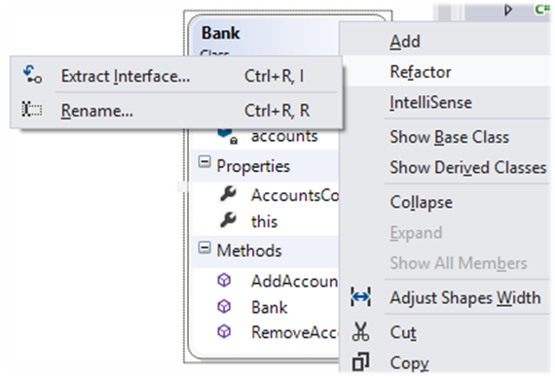
Class Level Refactorings
Change structure to class and vice versa
Pull members up / push members down the hierarchy
Extract specialized code into a subclass
Combine similar code into a superclass
Collapse hierarchy
Replace inheritance with delegation
Replace "is-a" with "has-a" relationship
Replace delegation with inheritance

Slide 33
Class Interface Refactorings
Extract interface(s) / Keep interface segregation
Move a method to another class
Convert a class to two
Delete a class
Hide a delegating class (A calls B and C when A should call B and B call C)
Remove the man in the middle
Introduce (use) an extension class
When we don’t have access to the original class
Alternatively use decorator pattern

Slide 34
Class Interface Refactorings (2)
Encapsulate an exposed member variable
In C# always use properties
Define proper access to getters and setters
Remove setters to read-only data
Hide data and routines that are not intended to be used outside of the class / hierarchy
private -> protected -> internal -> public
Use strategy to avoid big class hierarchies
Apply other design patterns to solve common class and class hierarchy problems (façade, adapter, etc.)

Slide 35
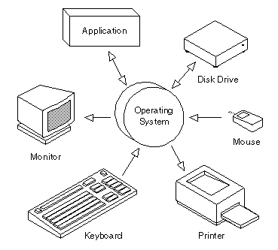
System Level Refactorings
Move class (set of classes) to another namespace / assembly
Provide a factory method instead of a simple constructor / Use fluent API
Replace error codes with exceptions
Extract strings to resource files
Use dependency injection
Apply architecture patterns

Slide 36



Refactoring Patterns
Well-Known Recipes for Improving the Code Quality

Slide 37
Rafactoring Patterns
When should we perform refactoring of the code?
Bad smells in the code indicate need of refactoring
Unit tests guarantee that refactoring does not change the behavior
Rafactoring patterns
Large repeating code fragments → extract repeating code in separate method
Large methods → split them logically
Large loop body or deep nesting → extract method

Slide 38
Refactoring Patterns (2)
Refactoring patterns
Class or method has weak cohesion → split into several classes / methods
Single change carry out changes in several classes → classes have tight coupling → consider redesign
Related data are always used together but are not part of a single class → group them in a class
A method has too many parameters → create a class to groups parameters together
A method calls more methods from another class than from its own class → move it

Slide 39
Rafactoring Patterns (3)
Refactoring patterns
Two classes are tightly coupled → merge them or redesign them to separate their responsibilities
Public non-constant fields → make them private and define accessing properties
Magic numbers in the code → consider extracting constants
Bad named class / method / variable → rename it
Complex boolean condition → split it to several expressions or method calls

Slide 40
Rafactoring Patterns (4)
Refactoring patterns
Complex expression → split it into few simple parts
A set of constants is used as enumeration → convert it to enumeration
Method logic is too complex and is hard to understand → extract several more simple methods or even create a new class
Unused classes, methods, parameters, variables → remove them
Large data is passed by value without a good reason → pass it by reference

Slide 41
Rafactoring Patterns (5)
Refactoring patterns
Few classes share repeating functionality → extract base class and reuse the common code
Different classes need to be instantiated depending on configuration setting → use factory
Code is not well formatted → reformat it
Too many classes in a single namespace → split classes logically into more namespaces
Unused using definitions → remove them
Non-descriptive error messages → improve them
Absence of defensive programming → add it

Slide 42
Refactoring
http://academy.telerik.com

Slide 43
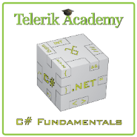



Free Trainings @ Telerik Academy
C# Programming @ Telerik Academy
csharpfundamentals.telerik.com
Telerik Software Academy
academy.telerik.com
Telerik Academy @ Facebook
facebook.com/TelerikAcademy
Telerik Software Academy Forums
forums.academy.telerik.com

